Slide 1
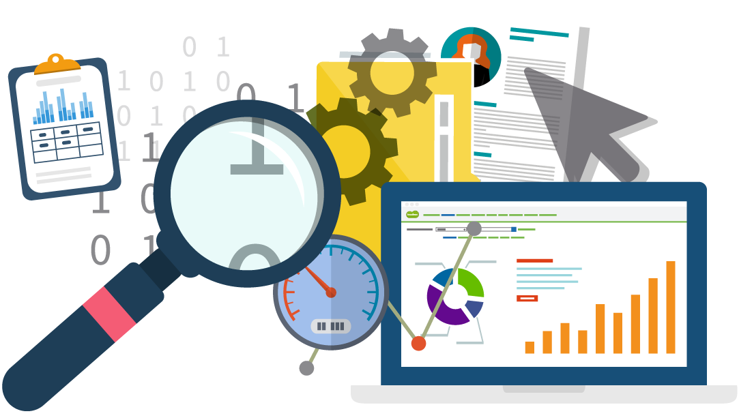
WORLD OF DATA SCIENCE
Webinar on Data Analysis with Python

Slide 2
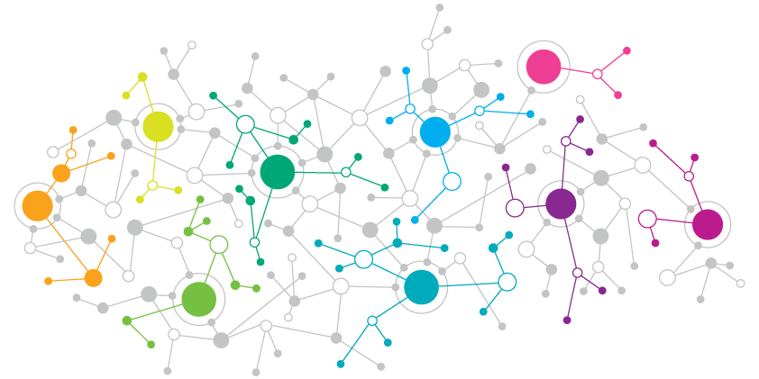
About this Webinar
What is Data Science and Data Analysis?
Introduction to Jupyter Notebook
Introduction to Python Programming
Introduction to Numpy
Introduction to Pandas
Data Cleaning using Pandas
Data Visualization and many more.

Slide 3
WHAT IS DATA SCIENCE?

Slide 4
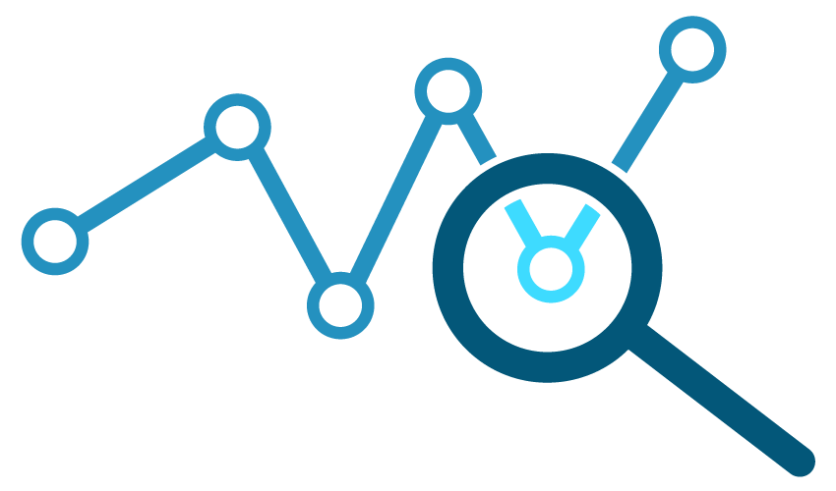
Inter-disciplinary field that uses scientific methods, processes, algorithms and systems to extract knowledge and insights from many structural and unstructured data.
DATA SCIENCE

Slide 5
Study of Data - recording, storing and analyzing data to extract information.
DATA SCIENCE

Slide 6
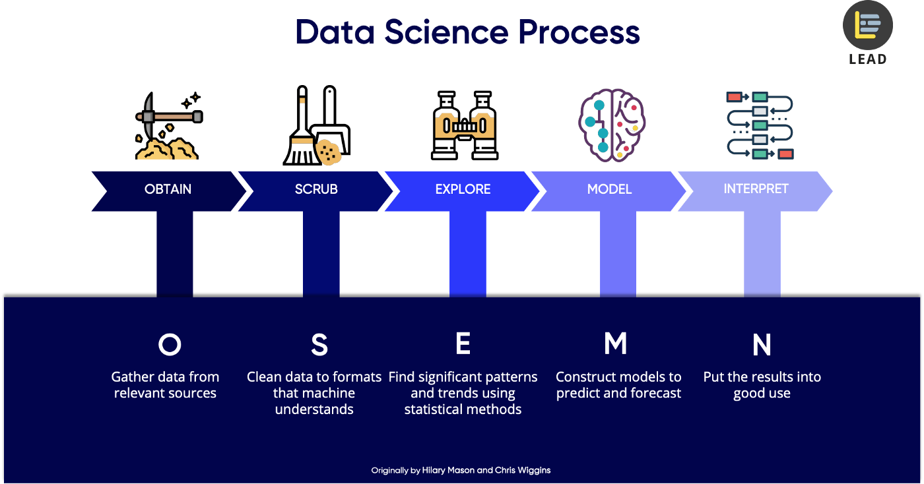

Slide 7
WHAT IS DATA ANALYSIS?

Slide 8
Process of inspecting, cleansing, transforming and modeling data with the goal of discovering useful information, informing conclusion and supporting decision-making.
DATA ANALYSIS

Slide 9
Process of inspecting, cleansing, transforming and modeling data with the goal of discovering useful information, informing conclusion and supporting decision-making.
DATA ANALYSIS

Slide 10
DATA ANALYSIS PROCESS

Slide 11
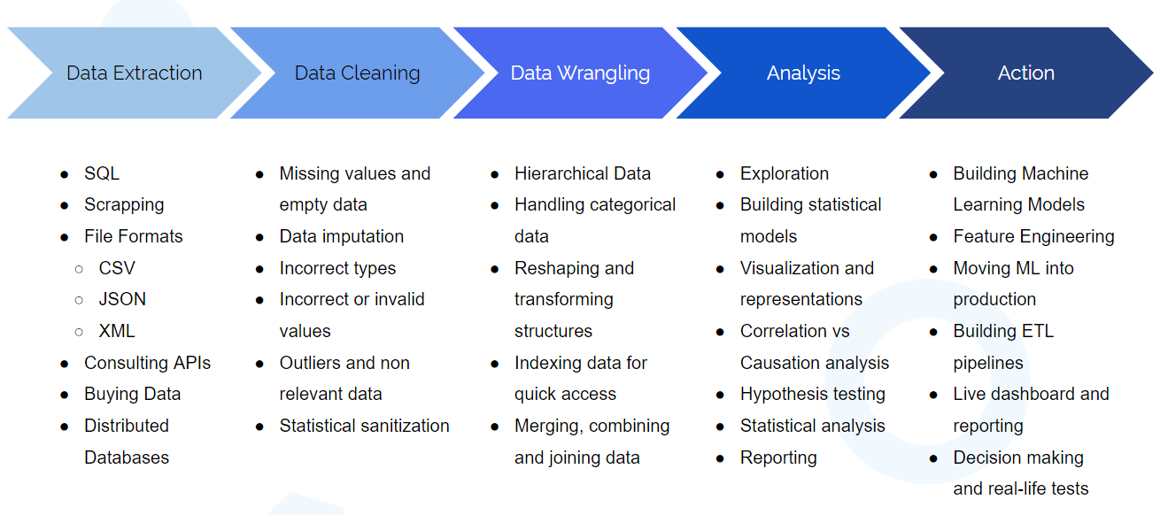

Slide 12
TOOLS FOR DATA ANALYSIS

Slide 13



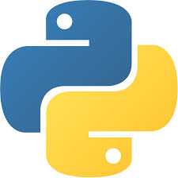
Tools
Programming Language
Tools are closed source and Programming Language are open source

Slide 14
WHY PYTHON?

Slide 15
Simple and Easy to Learn
WHY PYTHON?
Powerful libraries
Free and Open Source
Amazing Community and documentation

Slide 16
About this Webinar
What is Data Science and Data Analysis?
Introduction to Jupyter Notebook
Introduction to Python Programming
Introduction to Numpy
Introduction to Pandas
Data Cleaning using Pandas
Data Visualization and many more.

